Slide 1
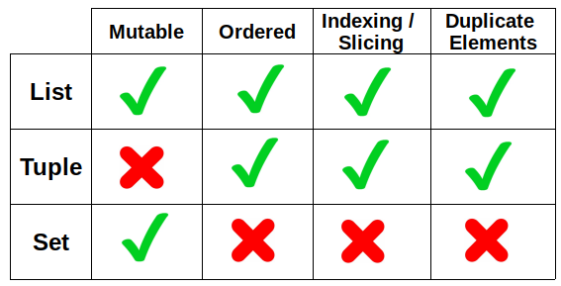
Python Advanced Advanced Concepts using Python lists, tuples, sets & dictionaries
Module - 2
Presentation By
Mohammed Tahir Mirji
MTech CS

Slide 2
CONTENTS
Working with python lists and built-in functions
Construct list in a natural way with list comprehensions.
Understanding of tuples and differences with python list
Deep dive into sets, dictionaries and work with
Assignments
Code Examples Github Link

Slide 3
Working with python lists and built-in functions
Sr.No | Function with Description
1 | cmp(list1, list2)Compares elements of both lists.
2 | len(list)Gives the total length of the list.p>
3 | max(list)Returns item from the list with max value.
4 | min(list)Returns item from the list with min value.
5 | list(seq)Converts a tuple into list.
Let’s code

Slide 4
Working with python lists and its methods
Sr.No | Methods with Description
1 | list.append(obj)Appends object obj to list
2 | list.count(obj)Returns count of how many times obj occurs in list
3 | list.extend(seq)Appends the contents of seq to list
4 | list.index(obj)Returns the lowest index in list that obj appears
5 | list.insert(index, obj)Inserts object obj into list at offset index
6 | list.pop(obj=list[-1])Removes and returns last object or obj from list
7 | list.remove(obj)Removes object obj from list
8 | list.reverse()Reverses objects of list in place
9 | list.sort([func])Sorts objects of list, use compare func if given
Let’s code

Slide 5
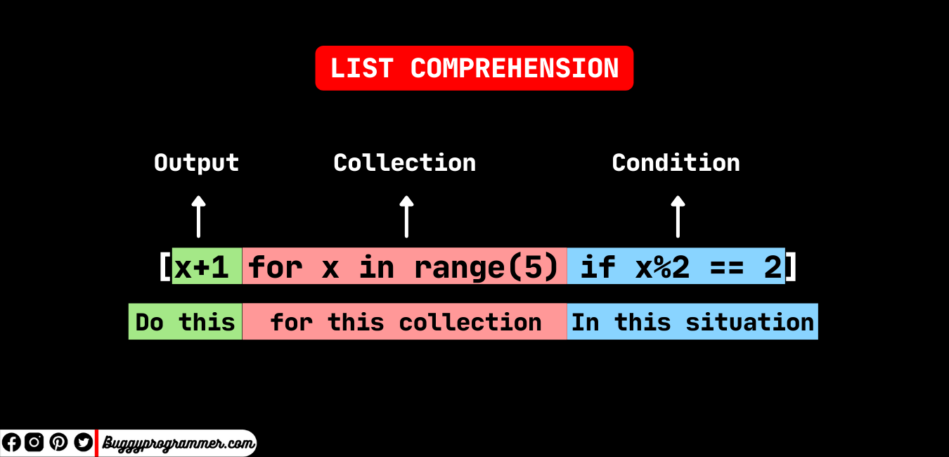
Construct list in a natural way with list comprehensions.
List Comprehension
List comprehension offers a shorter syntax when you want to create a new list based on the values of an existing list.

Slide 6
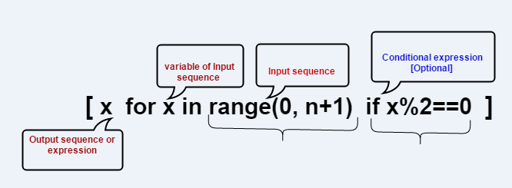
Construct list in a natural way with list comprehensions.

Slide 7
Construct list in a natural way with list comprehensions.
Example:
Based on a list of fruits, you want a new list, containing only the fruits with the letter "a" in the name.
Without list comprehension you will have to write a for statement with a conditional test inside:
A Python list comprehension consists of brackets containing the expression, which is executed for each element along with the for loop to iterate over each element in the Python list.

Slide 8
Construct list in a natural way with list comprehensions.
Syntax:
newlist = [expression for item in iterable if condition == True]
The return value is a new list, leaving the old list unchanged.
The condition is like a filter that only accepts the items that valuate to True.
The iterable can be any iterable object, like a list, tuple, set etc.
The expression is the current item in the iteration, but it is also the outcome, which you can manipulate before it ends up like a list item in the new list.

Slide 9
Construct list in a natural way with list comprehensions.
Code Examples:
Condition
newlist = [x for x in fruits if x != "apple"]
Iterable
newlist = [x for x in range(10)]
newlist = [x for x in range(10) if x < 5]
Expression
newlist = [x.upper() for x in fruits]
newlist = ['hello' for x in fruits]
newlist = [x if x != "banana" else "orange" for x in fruits]

Slide 10
Construct list in a natural way with list comprehensions.
Example 1:
# Using list comprehension to iterate through loop
List = [character for character in [1, 2, 3]]
# Displaying list
print(List)
Example 2:
list = [i for i in range(11) if i % 2 == 0]
print(list)

Slide 11
Construct list in a natural way with list comprehensions.
Example 4:
# Empty list
List = []
# Traditional approach of iterating
for character in ‘Get set go’:
List.append(character)
# Display list
print(List)
Example 3:
matrix = [[j for j in range(3)] for i in range(3)]
print(matrix)

Slide 12
Construct list in a natural way with list comprehensions.
Example 5:
matrix = []
for i in range(3):
# Append an empty sublist inside the list
matrix.append([])
for j in range(5):
matrix[i].append(j)
print(matrix)

Slide 13
Construct list in a natural way with list comprehensions.
Example without list comprehension:
fruits = ["apple", "banana", "cherry", "kiwi", "mango"] newlist = [] for x in fruits: if "a" in x: newlist.append(x) print(newlist)
Example with list comprehension:
fruits = ["apple", "banana", "cherry", "kiwi", "mango"] newlist = [x for x in fruits if "a" in x] print(newlist)

Slide 14
Understanding of tuples and differences with python list
When choosing a collection type, it is useful to understand the properties of that type.
Choosing the right type for a particular data set could mean retention of meaning, and, it could mean an increase in efficiency or security.

Slide 15
Understanding of tuples and differences with python list
A Tuple is also a sequence data type that can contain elements of different data types, but these are immutable in nature. In other words, a tuple is a collection of Python objects separated by commas. The tuple is faster than the List because of static in nature.
# Creating a Tuple
Tuple1 = (5, 'Welcome', 7, ‘Students’)
print(Tuple1)
List1=[1,2,’Hello’]
print(List1)

Slide 16
Understanding of tuples and differences with python list
SR.NO. | LIST | TUPLE
1 | Lists are mutable | Tuples are immutable
2 | The implication of iterations is Time-consuming | The implication of iterations is comparatively Faster
3 | The list is better for performing operations, such as insertion and deletion. | Tuple data type is appropriate for accessing the elements
4 | Lists consume more memory | Tuple consumes less memory as compared to the list
5 | Lists have several built-in methods | Tuple does not have many built-in methods.
6 | The unexpected changes and errors are more likely to occur | In tuple, it is hard to take place.

Slide 17
Understanding of tuples and differences with python list
Difference in memory usage:
import sys
a_list = list()
a_tuple = tuple()
a_list = [1,2,3,4,5]
a_tuple = (1,2,3,4,5)
print(sys.getsizeof(a_list),"Bytes")
print(sys.getsizeof(a_tuple),"Bytes")

Slide 18
Conclusion of differences with python tuples and list
A list has a variable size while a tuple has a fixed size. Operations on tuples can be executed faster compared to operations on lists.

Slide 19
Deep dive into sets, dictionaries and work with loops
The major advantage of using a set, as opposed to a list, is that it has a highly optimized method for checking whether a specific element is contained in the set. This is based on a data structure known as a hash table. Since sets are unordered, we cannot access items using indexes like we do in lists.
Methods for Sets
Adding elements
Union
Intersection
Difference
Clearing sets

Slide 20
Adding Elements
# Creating a Set
people = {"Jay", "Idrish", "Archi"}
print("People:", end = " ")
print(people)
# This will add Daxit
# in the set
people.add("Daxit")
# Adding elements to the
# set using iterator
for i in range(1, 6):
people.add(i)
print("\nSet after adding element:", end = " ")
print(people)
Insertion in set is done through set.add() function, where an appropriate record value is created to store in the hash table.

Slide 21
Union
people = {"Jay", "Idrish", "Archil"}
vampires = {"Karan", "Arjun"}
dracula = {"Deepanshu", "Raju"}
# Union using union()
# function
population = people.union(vampires)
print("Union using union() function")
print(population)
# Union using "|"
# operator
population = people|dracula
print("\nUnion using '|' operator")
print(population)
Two sets can be merged using union() function or | operator. Both Hash Table values are accessed and traversed with merge operation perform on them to combine the elements, at the same time duplicates are removed.

Slide 22
Intersection
set1 = set()
set2 = set()
for i in range(5):
set1.add(i)
for i in range(3,9):
set2.add(i)
# intersection() function
set3 = set1.intersection(set2)
print("Intersection using intersection() function")
print(set3)
# Intersection using
# "&" operator
set3 = set1 & set2
print("\nIntersection using '&' operator")
print(set3)
This can be done through intersection() or & operator. Common Elements are selected. They are similar to iteration over the Hash lists and combining the same values on both the Table.

Slide 23
Difference
set1 = set()
set2 = set()
for i in range(5):
set1.add(i)
for i in range(3,9):
set2.add(i)
# Difference of two sets
# using difference() function
set3 = set1.difference(set2)
print(" Difference of two sets using difference() function")
print(set3)
# Difference of two sets
# using '-' operator
set3 = set1 - set2
print("\nDifference of two sets using '-' operator")
print(set3)
To find difference in between sets. Similar to find difference in linked list.

Slide 24
Clearing sets
set1 = {1,2,3,4,5,6}
print("Initial set")
print(set1)
# This method will remove
# all the elements of the set
set1.clear()
print("\nSet after using clear() function")
print(set1)
Clear() method empties the whole set.

Slide 25
However, there are two major pitfalls in Python sets:
The set doesn’t maintain elements in any particular order.
Only instances of immutable types can be added to a Python set.

Slide 26
Operators for Sets
Operators | Notes
key in s | containment check
key not in s | non-containment check
s1 == s2 | s1 is equivalent to s2
s1 != s2 | s1 is not equivalent to s2
s1 <= s2 | s1 is subset of s2
s1 < s2 | s1 is proper subset of s2

Slide 27
Operators for Sets
Operators | Notes
s1 >= s2 | s1 is superset of s2
s1 > s2 | s1 is proper superset of s2
s1 | s2 | the union of s1 and s2
s1 & s2 | the intersection of s1 and s2
s1 – s2 | the set of elements in s1 but not s2
s1 ˆ s2 | the set of elements in precisely one of s1 or s2

Slide 28
Deep dive into sets, dictionaries and work with loops
Dictionary in Python is a collection of keys values, used to store data values like a map, which, unlike other data types which hold only a single value as an element.
Nested Dictionary
# Creating a Nested Dictionary
# as shown in the below image
Dict = {1: 'Geeks', 2: 'For', 3: {'A': 'Welcome', 'B': 'To', 'C': 'Geeks'}}
print(Dict)

Slide 29
Adding elements to a Dictionary
Addition of elements can be done in multiple ways. One value at a time can be added to a Dictionary by defining value along with the key e.g. Dict[Key] = ‘Value’. Updating an existing value in a Dictionary can be done by using the built-in update() method. Nested key values can also be added to an existing Dictionary.
Program Nex t>>

Slide 30
Accessing an element of a nested dictionary
In order to access the value of any key in the nested dictionary, use indexing [] syntax.
# Creating a Dictionary
Dict = {'Dict1': {1: 'Geeks'},
'Dict2': {'Name': 'For'}}
# Accessing element using key
print(Dict['Dict1'])
print(Dict['Dict1'][1])
print(Dict['Dict2']['Name'])

Slide 31
Dictionary methods
Functions Name | Description
clear() | Removes all items from the dictionary
copy() | Returns a shallow copy of the dictionary
fromkeys() | Creates a dictionary from the given sequence
get() | Returns the value for the given key
items() | Return the list with all dictionary keys with values

Slide 32
Dictionary methods
Functions Name | Description
keys() | Returns a view object that displays a list of all the keys in the dictionary in order of insertion
pop() | Returns and removes the element with the given key
popitem() | Returns and removes the key-value pair from the dictionary
setdefault() | Returns the value of a key if the key is in the dictionary else inserts the key with a value to the dictionary
update() | Updates the dictionary with the elements from another dictionary
values() | Returns a list of all the values available in a given dictionary

Slide 33
Dictionary methods
# keys() method
print(dict2.keys())
# pop() method
dict2.pop(4)
print(dict2)
# popitem() method
dict2.popitem()
print(dict2)
# update() method
dict2.update({3: "Scala"})
print(dict2)
# values() method
print(dict2.values())
# demo for all dictionary methods
dict1 = {1: "Python", 2: "Java", 3: "Ruby", 4: "Scala"}
# copy() method
dict2 = dict1.copy()
print(dict2)
# clear() method
dict1.clear()
print(dict1)
# get() method
print(dict2.get(1))
# items() method
print(dict2.items())

Slide 34
Sets work with loops
Method #1: Iterating over a set using simple for loop.
# Creating a set using string
test_set = set(“PYTHON")
# Iterating using for loop
for val in test_set:
print(val)
Method #2: Iterating over a set using simple for loop.
# Creating a set using string
test_set = set(“Python")
# Iterating using enumerated for loop
for id,val in enumerate(test_set):
print(id, val)

Slide 35
Dictionary work with loops
There are multiple ways to iterate over a dictionary in Python.
Access key using the build .keys()
Access key without using a key()
Iterate through all values using .values()
Iterate through all key, and value pairs using items()
Access both key and value without using items()
Print items in Key-Value in pair

Slide 36
Dictionary work with loops
statesAndCapitals = {
'Gujarat': 'Gandhinagar',
'Maharashtra': 'Mumbai',
'Rajasthan': 'Jaipur',
'Bihar': 'Patna'
}
keys = statesAndCapitals.keys()
print(keys)
Example 1: Access key using the build .keys()
Using an in-build. keys() method which helps us to print all the keys in the dictionary.

Slide 37
Dictionary work with loops
statesAndCapitals = {
'Gujarat': 'Gandhinagar',
'Maharashtra': 'Mumbai',
'Rajasthan': 'Jaipur',
'Bihar': 'Patna'
}
print('List Of given states:\n')
# Iterating over keys
for state in statesAndCapitals:
print(state)
Example 2: Access key without using a key()
Iterating over dictionaries using ‘for’ loops for iterating our keys and printing all the keys present in the Dictionary.

Slide 38
Assignments

Slide 39
Code for the presentation can be found here
Refer Readme.md of github repository for list of assignments:
https://github.com/tahirmirji/ai_with_python_keonics

Slide 40
Thank You

